Slide 1
Project Two Presentation

Slide 2
What does Sat Scores data say?
The data set shows Math, Verbal, Rate in 52 States
No cleaning data needed
How many states are above the mean and median
Verbal =negative skewed, 24 (46%)state the mean, 26 state (50%) median
Math = negative skewed, 23 (44%)state above the mean, 26 state (50%) median
if the mean is lower than median, most student score above average, or >46%, the lower score is really low bring down the score, despite with student with higher score

Slide 3

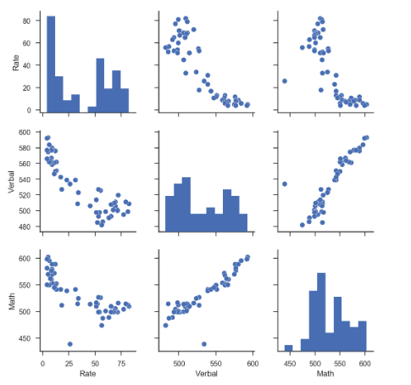
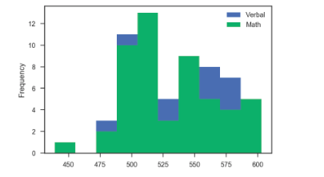
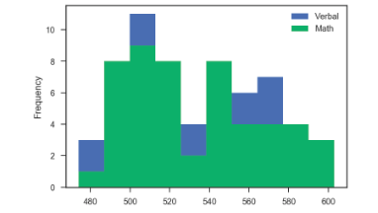
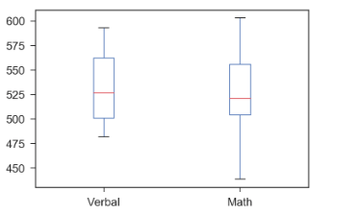
Sats Score
Pair Plot : positive correlation between Math and Verbal
Student who have high score in verbal probably will have high score in math and the opposite apply
99%(3std)
95%(2 std) 1 math outlier
Math have lower 25% and higher 75% than verbal
Math score have more varied in high and low score causing the whisker to be longer than verbal
students more in higher median both in Math and Verbal
Verbal median higher than math median
Verbal mean is higher than math mean
the box show where the data concentrated
68%(1 std)= outlier math 15, verbal 20

Slide 4
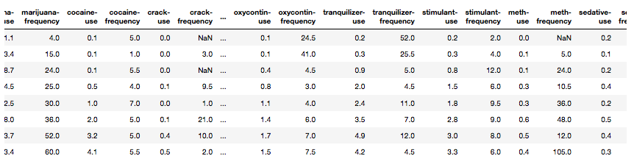

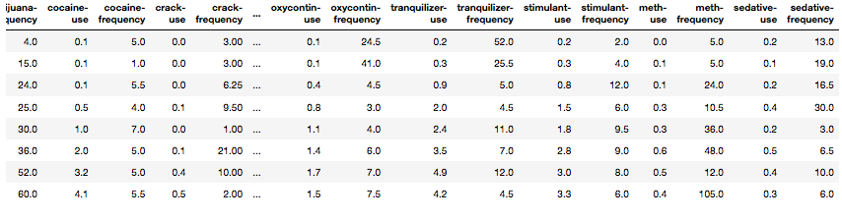
Drug Data
Drug data : 17 rows, 28 columns
: 13 drugs types, 17 age groups
:There are 9 missing data
Cleaning data:
Assumption: There must be missing data inside, using interpolate to replace null with some values
(Interpolation is an estimation of a value within two known values in a sequence of values)

Slide 5
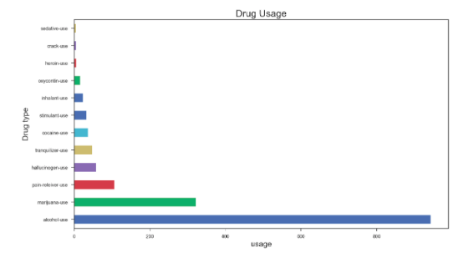
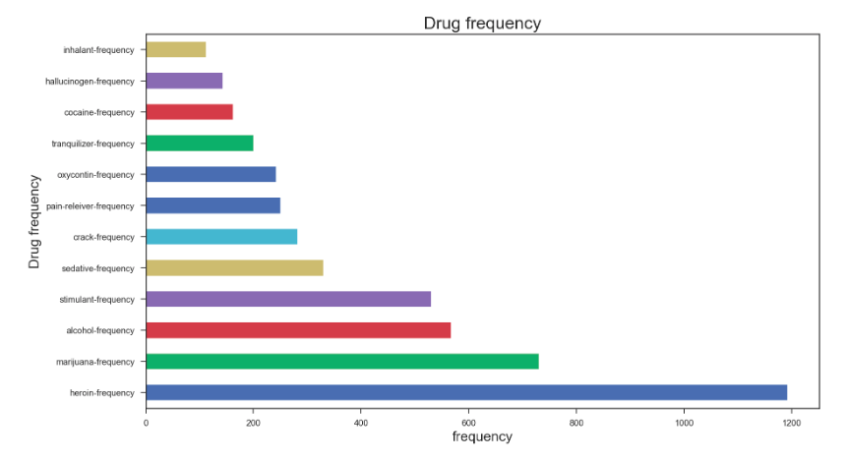
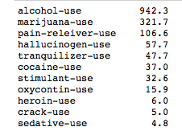
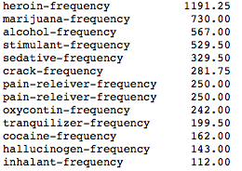
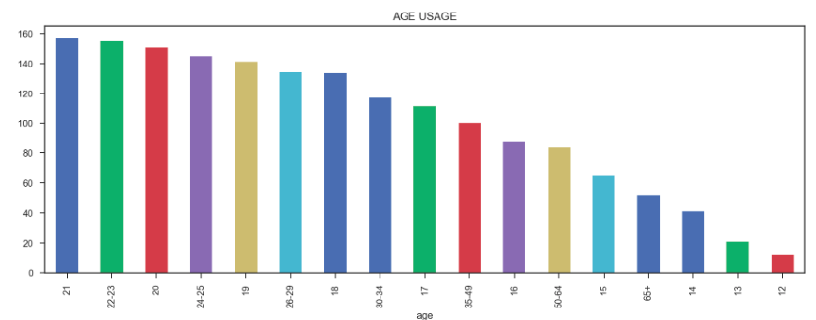
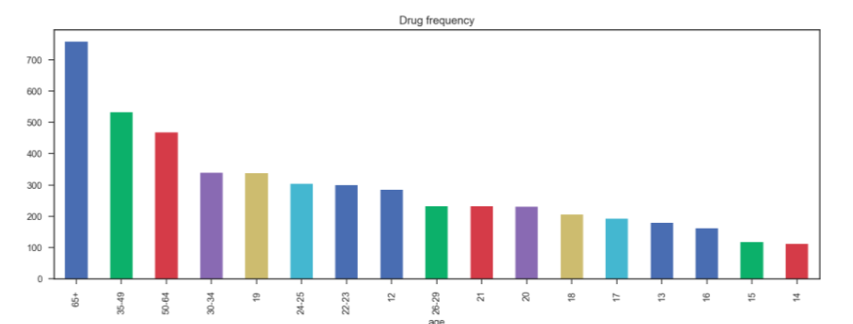


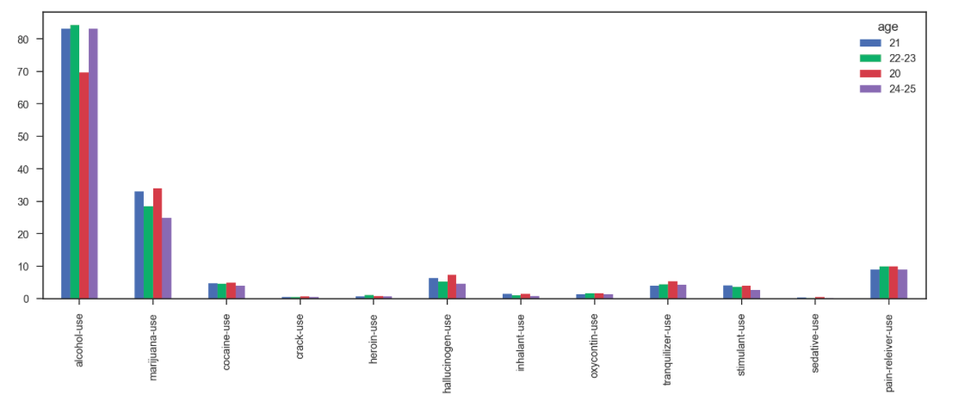
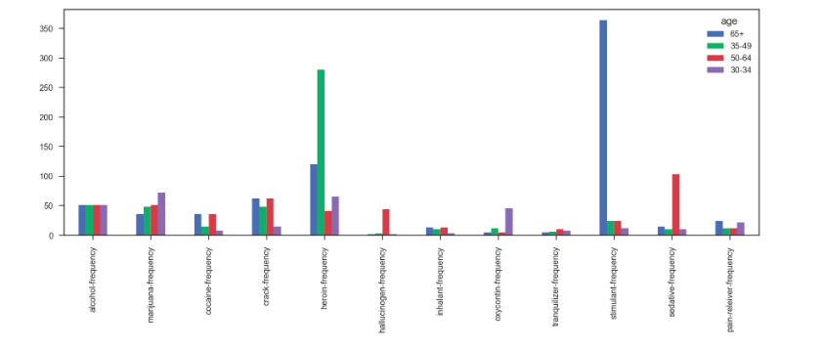
Drug Data
Alcohol use can be found in beer, wine even some food
Marijuana illegal sale all over the world despite of expensive price
sedative use fin anti anxiety drug that calm patient, permitting sleep
heroin use :relieve pain or in opioid replacement therapy
stimulant use :treat attention-deficit hyperactivity disorder (ADHD) and narcolepsy—uncontrollable episodes of deep sleep

Slide 6
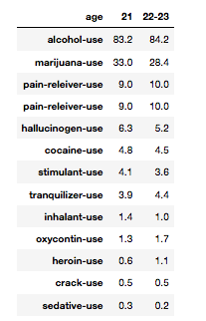
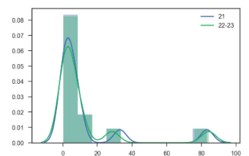
Hypotesis 1
Ho = there is no relation drug use in age 21 and 22-23
Ha = there is relation drug use in age 21 and 22-23
Using scipy.stats: t_stat = stats.ttest_ind(sample2, sample1,equal_var = False)
Scipy t-statistic: t = -0.02 p = 9.83e-01
Accept null hypothesis. There is no significant correlation between the dataset.

Slide 7
Drug Data
Next step :
1 To make drug data set in same level which is per age
2 Get real value instead of median and percentage
3 Get remaining data up to 80+ years, to analyse further whether the frequency of drug use increase or decrease
Prediction that i wanted to clarify:
is the older you are you need to consume more drug to slow down the sickness and sustain longer life??
or
will they use less as they grow older

Slide 8
Thank You

